Slide 1
Multiprocessing in Python
Tucson Python Meetup
July 7th 2020
Ian Bertolacci
ian-bertolacci.github.io
(Available for hire!)
Code and materials available at github.com/ian-bertolacci/Multiprocessing-in-Python-Tucson-Python-Meetup

Slide 2
Python Performance Disclaimer
Python is not a high performance programming language.
Write in a faster language if you need extremely fast applications.
Use fast libraries!
Have fast implementations (though unlikely to be parallel).
NumPy, SciPy, Pandas, etc

Slide 3
Parallel Programming Disclaimer
Parallelism is not always the answer
Amdahl's law: speedup <= total_time / ( time_in_serial + ( time_in_parallel / processes ) )
If x% of a program is parallelizable, the BEST CASE is an x% reduction in runtime.
Period.
You will get less than that.
More Parallelism != Faster Program
Overhead of spawning parallel tasks.
Resource contention.
Profile! Experiment!
Is program slow because of amount of work? Or because implementation is algorithmically slow?

Slide 4
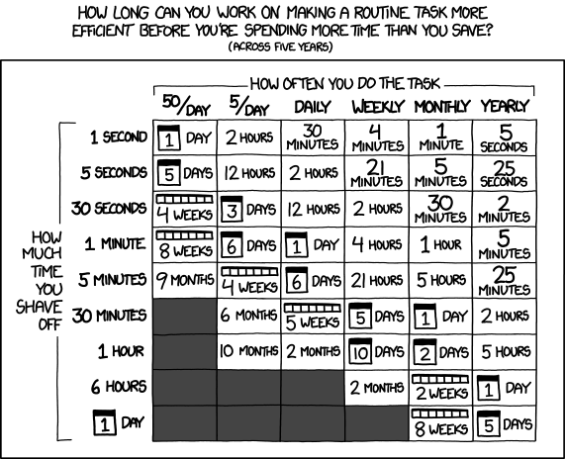
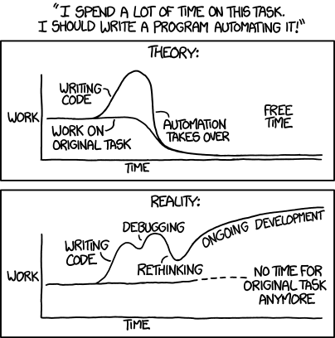
Parallel Programming Disclaimer
https://xkcd.com/1319/

Slide 5
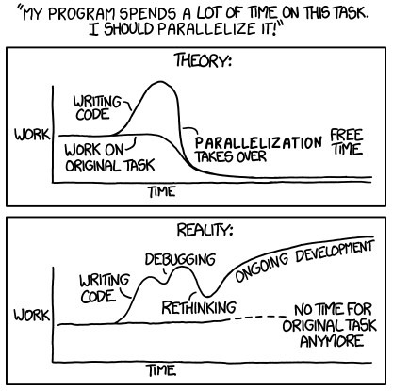
Parallel Programming Disclaimer
Based on https://xkcd.com/1319/

Slide 6
Breaking Down a Problem into Parallelism
What is "work"?
Multiple different tasks?
Implies task parallelism
Multiple identical tasks on different data?
Implies data parallelism
Dependencies
What tasks depend on other each other?
Implies ordering between tasks
What tasks share objects?
Implies communication between tasks.
What tasks are modifying shared objects?
Implies synchronization between tasks

Slide 7
Example: Adding Two Arrays
added_AB = [ a + b for a, b in zip(A, B) ]
What kind of work is happening here?
Same task, different data.
Are there dependencies between tasks?
No
All tasks operate independently.
Do tasks share data?
No
All tasks have their own data.

Slide 8
Example: Modifying, Sending, and Writing Data
fooized_data = fooize( data ) send_data( fooized_data, server_url ) json_write( fooized_data, "fooized.json" )
What kind of work is happening here?
Different tasks
Are there dependencies between tasks?
Yes
The send_data communication and json_write depend on the statement creating fooized_data
Do tasks share data?
Yes
The server communication and file output share fooized_data
Are tasks are modifying shared objects?
No
Because I made this example up and assume neither send_data or json_write modify the object

Slide 9
Python Multiprocessing
Standard Python library with API for parallel python programming.
Same API as Python Threading library (which is *not* parallel).
Excellent docs: docs.python.org/3/library/multiprocessing.html
Provides:
Parallelism via Processes and Process pools
Synchronization via Locks, Events, Barriers, etc...
Inter-process communication via Pipes, Queues, Shared Memory

Slide 10
Example: Data Parallelism using Pool.map
Original:
added_AB = [ a + b for a, b in zip(A, B) ]
Parallel:
with Pool( processes ) as pool:
added_AB = pool.starmap( operator.add, zip(A, B) )

Slide 11
Example: Parallel Reduction using Pool.map
Original:
sum_data = sum( data )
Parallel:
with Pool( processes ) as pool:
chunk_size = int( ceil( len(data)/processes ) )
chunked_work = [
data[ i : i + chunk_size ]
for i in range( 0, len(data), chunk_size )
]
partial_sum_data = pool.imap( sum, chunked_work, chunksize=1 )
sum_data = sum( partial_sum_data )

Slide 12
Some Notes on Pool.map
Careful about order!
if order of matters, make sure you're using the correct map function
Especially true for reduction operations.
A number of different map functions for different needs.
Asynchronous map
Starmap
Unordered map
Iterable map
Combinations of all

Slide 13
Example: Task Parallelism with Pool.apply
Original:
fooized_data = fooize( data ) send_data( fooized_data, server_url ) json_write( fooized_data, "fooized.json" )
Parallel:
fooized_data = fooize( data )
with Pool( processes ) as pool:
send_async = pool.apply_async( send_data, (fooized_data, server_url) )
write_async = pool.apply_async( json_write, (fooized_data, "fooized.json") )
send_result = send_async.get()
write_result = write_async.get()

Slide 14
Example: Task Parallelism with Process
Original:
fooized_data = fooize( data ) send_data( fooized_data, server_url ) json_write( fooized_data, "fooized.json" )
Parallel:
fooized_data = fooize( data )
processes = [
Process( target=send_data, args=(fooized_data, server_url) ),
Process( target=json_write, args=(fooized_data, "fooized.json") )
]
for process in processes: process.start()
for process in processes: process.join()

Slide 15
Process Communication and Shared Data
Different tasks may be independent until they need to share data.
Direct communication:
Pipes: connects two processes, can be bi-directional (Not covered here)
Queues: many-to-many FIFO queue
Shared Data/Memory
Values: wraps a C type variable with a lock.
Arrays: wraps an array of C type values with a lock.

Slide 16
Example: Queue
def make_work( queue, N ):
for work in range(N):
queue.put( work )
queue.put("dead")
def do_work( queue ):
while True:
work = queue.get()
if work == "dead":
break
print( f"got {work}" )
# main
items = 100
work_queue = Queue()
Process( target = make_work, args =(work_queue, items) ).start()
Process( target = do_work, args =(work_queue, ) ).start()

Slide 17
Example: Value
def writer( counter ):
with counter.get_lock():
while True:
counter.value += 1
def reader( counter ):
while True:
print( counter.value )
# main
shared_value = Value( "i", 0 )
Process( target = make_work, args =(shared_value, ) ).start()
Process( target = do_work, args =(shared_value, ) ).start()

Slide 18

But What About Non-ctype Shared Memory?
Managed Proxy Objects probably???

Slide 19
Synchronization
Lock
Mutual exclusion (of code sections and/or data)
A process acquires the lock then releases the lock
Event:
Many-on-one ordering
One-or-more processes wait on the event, a single process triggers it, unblocking all
Condition:
Conditional mutual exclusion (think lock + event)
Process waits, another process unblocks
Barriers:
Many-on-many ordering
All processes* must reach and wait at the barrier before all can proceed
Semaphore/BoundedSemaphore:
Capacity exclusion (think lock that can be opened by at most N keys simultaneously)
Only N processes may acquire the semaphore simultaneously

Slide 20
Example: Lock
def worker( id, array ):
while True:
array[id] += 1
def printer( id, lock, array ):
while True:
sleep( 1 )
with lock:
for v in array:
print( f"({id}) {v}" )
# main
array = Array( "i", [0] * workers )
lock = Lock()
[ Process( target = worker, args = (id, array) ).start() for id in … ]
[ Process( target = printer, args = (id, array, lock ) ).start() for id in … ]

Slide 21
Deadlocking
Processes can acquire multiple locks.
Deadlock occurs when two processes hold locks (a, b) while trying to acquire the other (b, a)
Neither can progress, essentially halting the program.
Easy to avoid if process will ever only hold one lock simultaneously.
Hard to avoid otherwise.
def foo( lock_a, lock_b ):
with lock_a:
with lock_b:
… stuff ...
def bar( lock_a, lock_b ):
with lock_b:
with lock_a:
… stuff ...

Slide 22
Example: Event and Barrier
def writer( id, array, barrier, event ):
while True:
event.wait()
while event.is_set():
array[id] += 1
barrier.wait()
def safe_reader( array, wbarrier, rbarrier, event ):
while True:
sleep( 1 )
event.clear()
wbarrier.wait()
local_copy = [ v for v in array ]
rbarrier.wait()
event.set()
print_info( local_copy )
# main
event = mp.Event()
write_barrier = mp.Barrier( writers + readers )
readers_barrier = mp.Barrier( readers )
event.set()
# … the rest of the program ...
Is this safe for multiple readers?
NO!

Slide 23
Parting Thoughts
Is multiprocessing for everyone? Certainly not.
Still hard to use
Parallel engineering is weirder than in other languages (shared memory in particular)
Is it useful? Mmmaybe?
Probably best for data parallelism
Hard to see where multiprocessing would be the best mechanism for task parallelism
Rapidly descends into microservices land
Hints:
Read those docs!!!!
Python.threading and Python.multiprocessing have a very common API (intentional)
Be ready to kill some processes manually

